Slide 1


Slide 2
satRday Nairobi 2021: Introduction
Organised by R-Ladies Nairobi in collaboration with NairobiR
The event consists of:
keynotes, workshops & talks on data manipulation, data visualisation, statistical modelling, R shiny, spatial analysis and R markdown.
an interactive Q&A session

Slide 3
Agenda
Morning Sessions:
Keynote; Telling Stories with Data: Communication in Data Science Science
Workshops; Introduction to Data Management in R(BW), Introduction to Package Development(IAW), Introduction to Mapping in R(BW), Modularising shiny apps(IAW), Talk: #TidyTuesday
Afternoon Sessions:
Keynote; Working on projects in R
Workshops; Making my first Shiny app(BW), Introduction to Tidy Models in R(IAW), Customizing RMarkdown
Talk; Create powerful dataviz with R
Our website here: https://nairobi2021.satrdays.org/

Slide 4

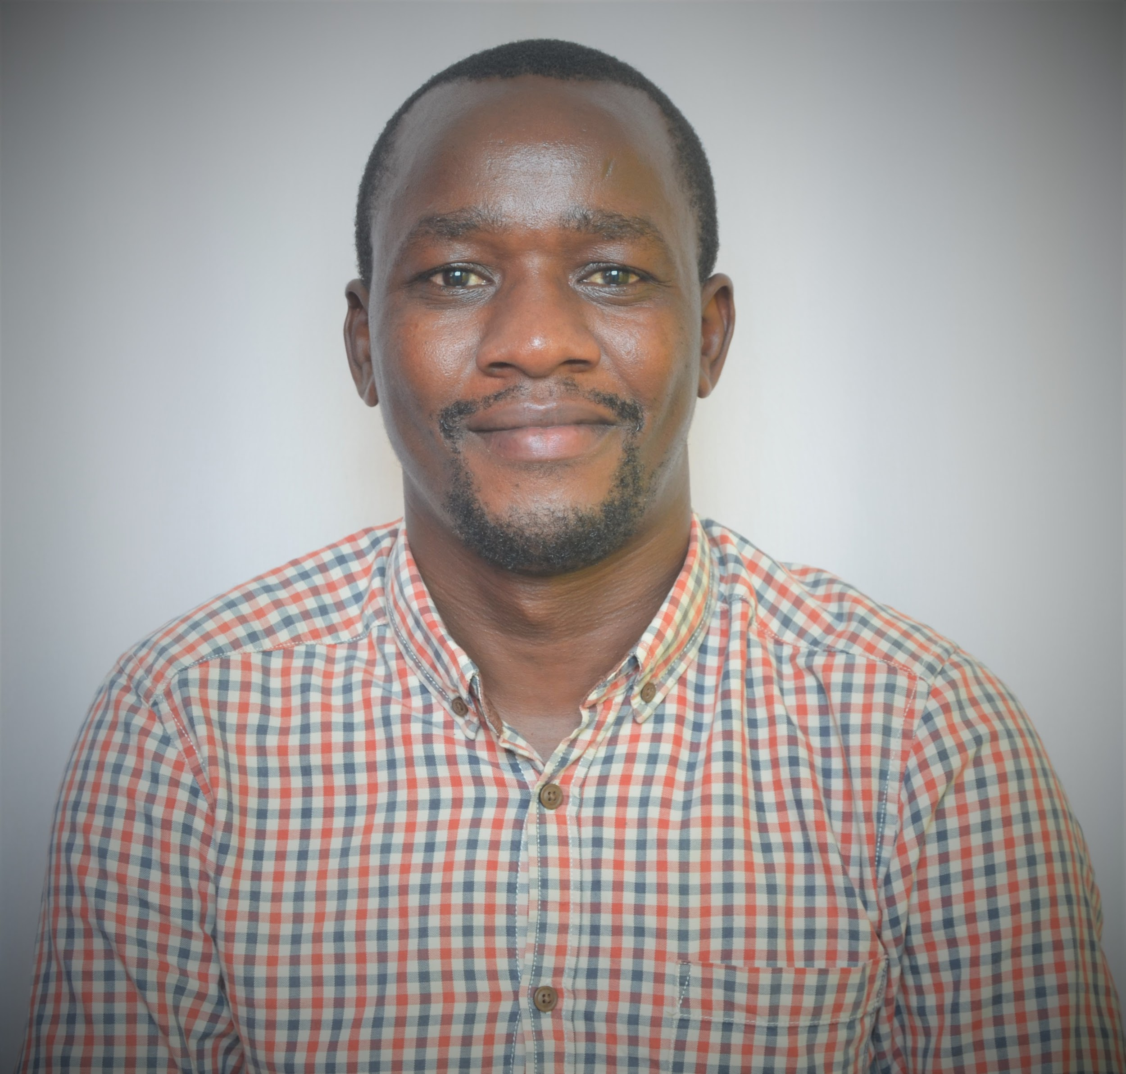
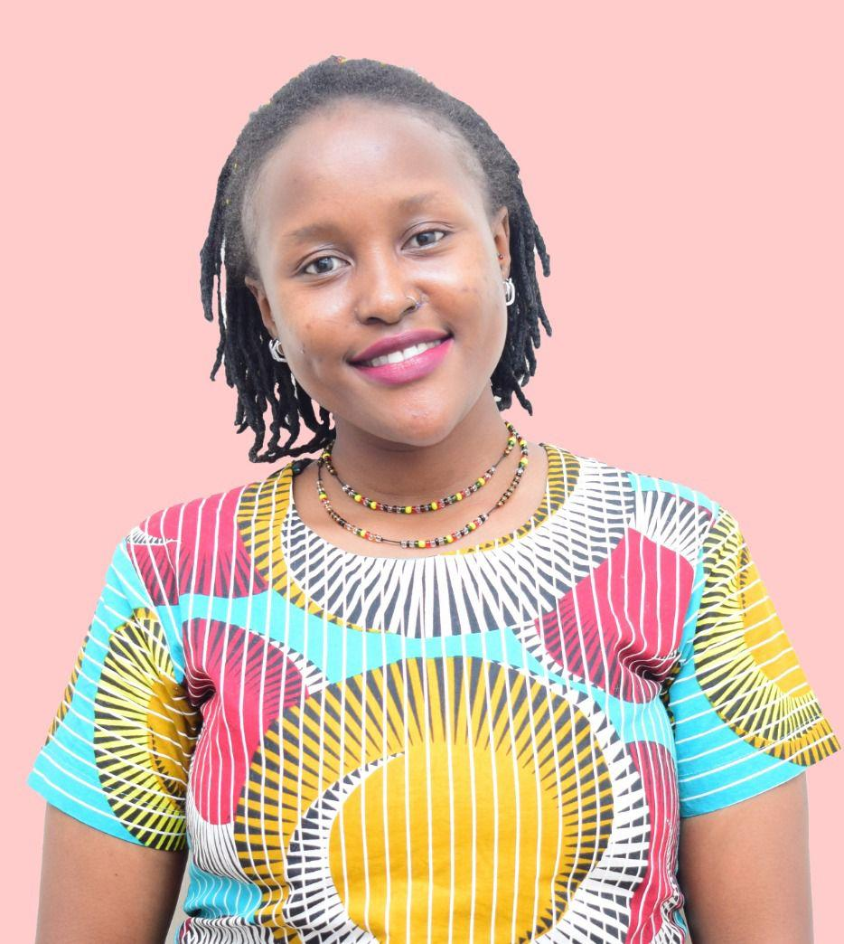
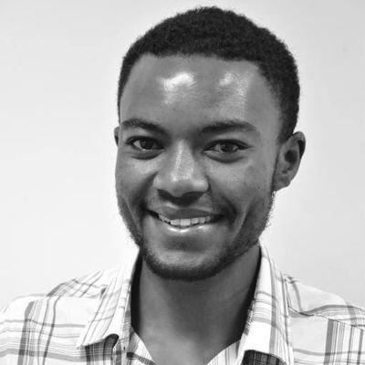
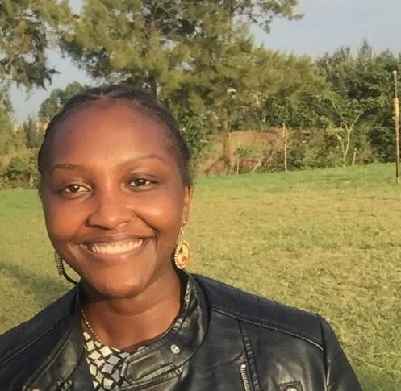
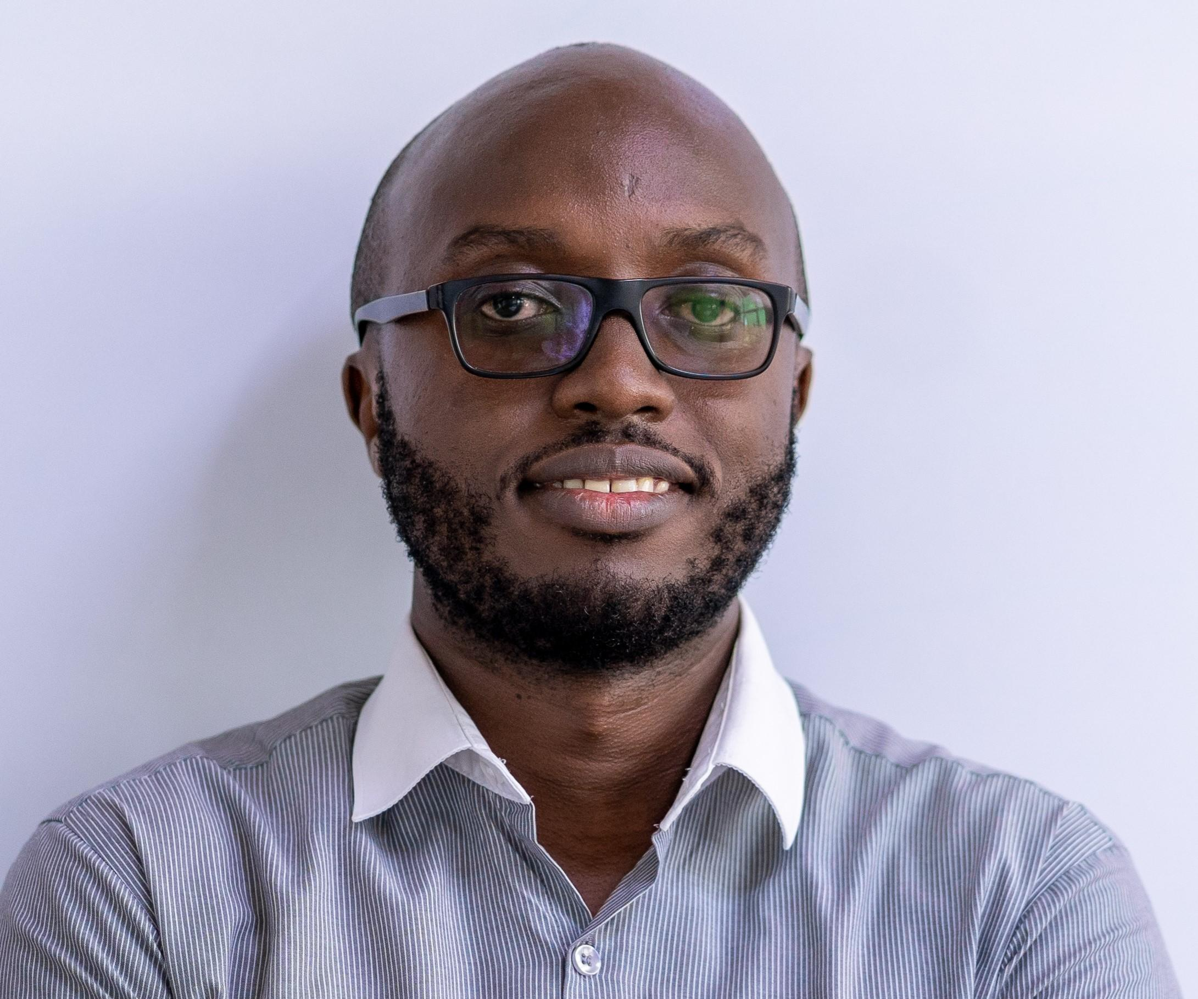
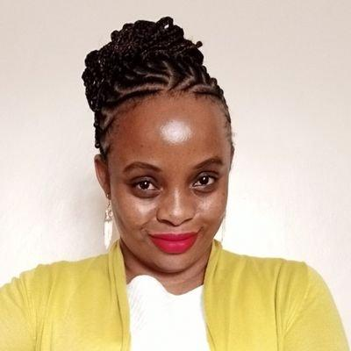
Organisers
Faith Musili
Christopher Maronga
Njoki Lucy
John Mutiso
Kigen Tembu
Shelmith Kariuki
Maggie Wanjiru

Slide 5
Guidelines for Participants
As R-Ladies Nairobi is part of R-Ladies Global, we strictly follow the R-Ladies Global code of conduct: https://rladies.org/code-of-conduct/ to ensure a safe place free of harassment to everyone.
Send questions to www.slido.com (code will be shared with the zoom host).
All sessions will be recorded and the recordings will be shared with the public.
Find us on social media via:
Email address: nairobi@rladies.org
LinkedIn: R-Ladies Nairobi
Twitter: @RLadiesNairobi/#NairobiR
Meetup: https://www.meetup.com/rladies-nairobi/

Slide 6
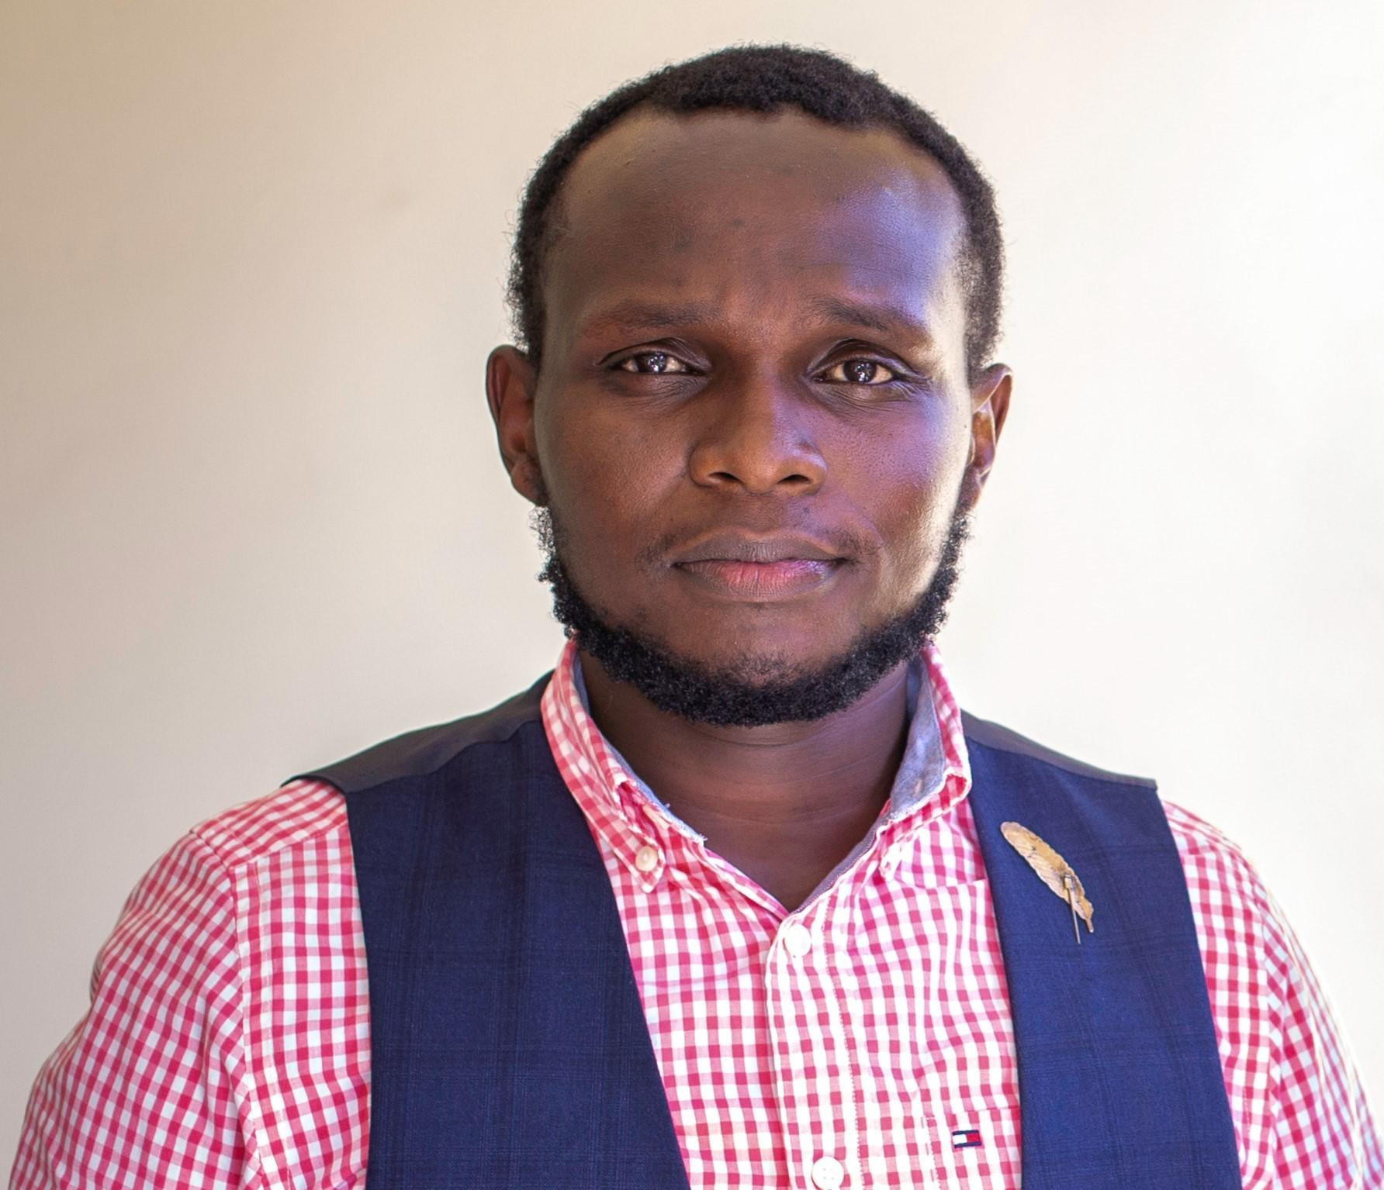
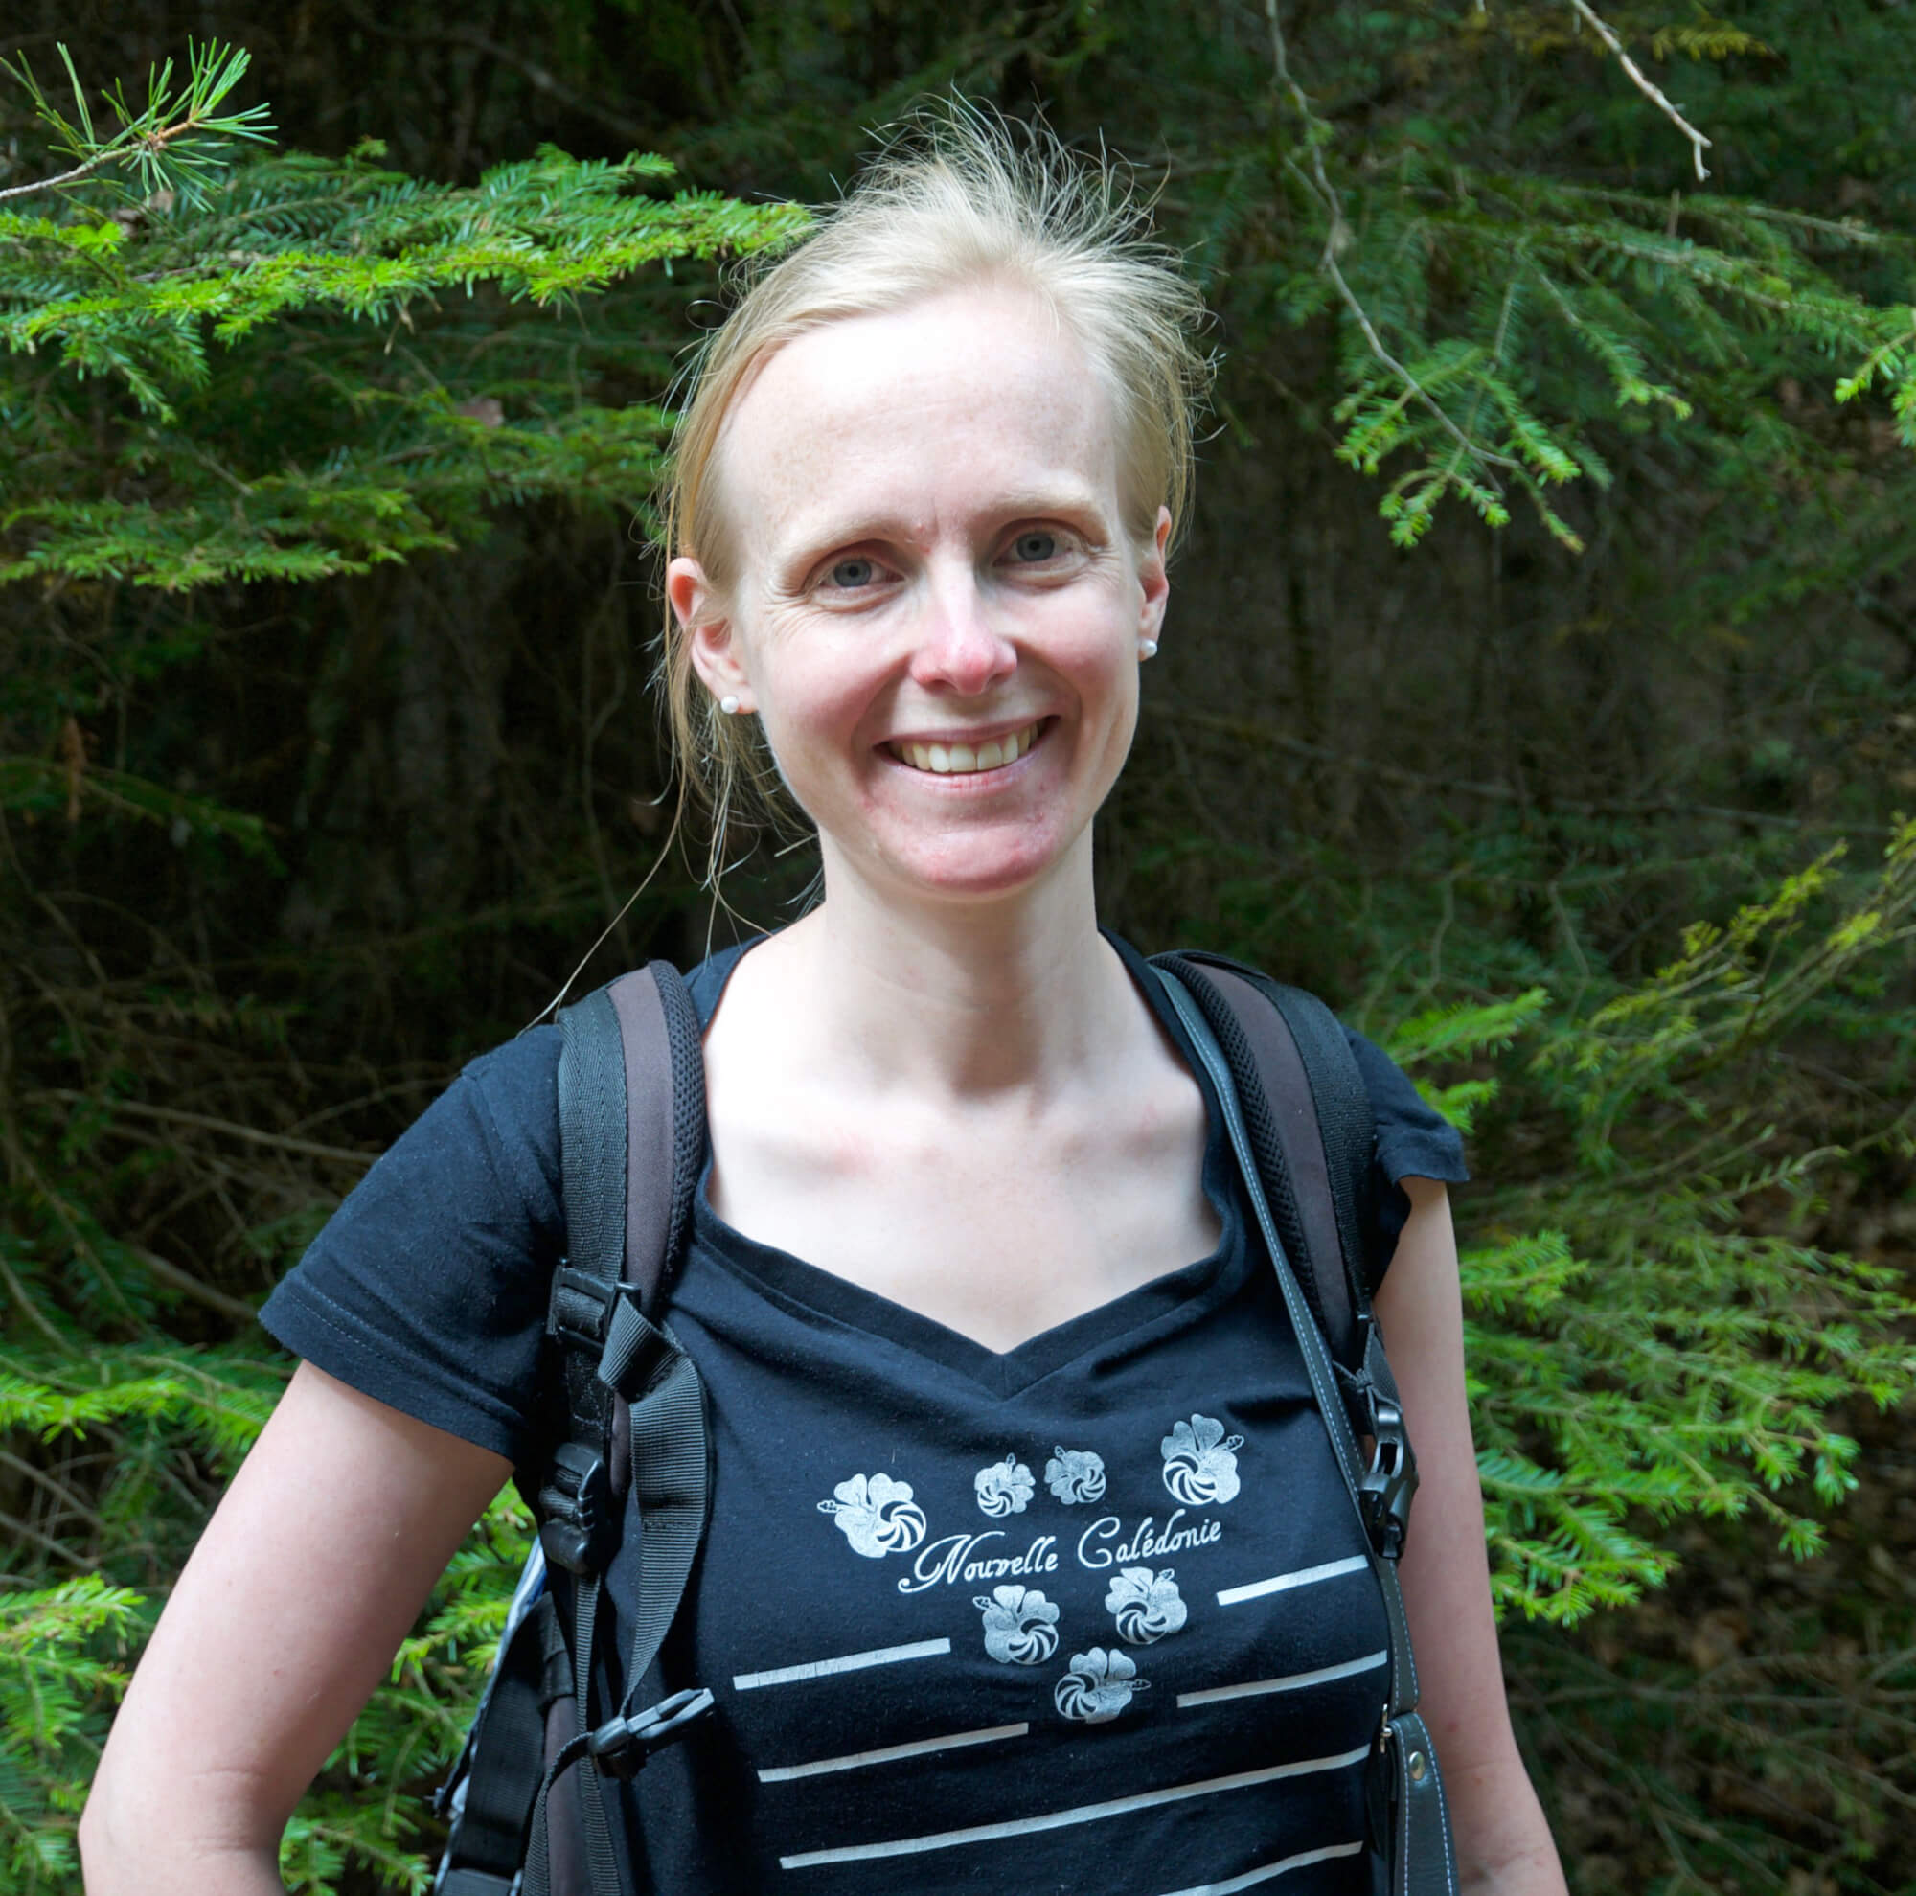
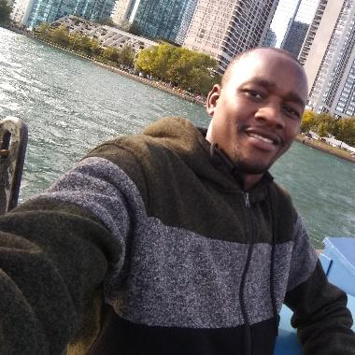
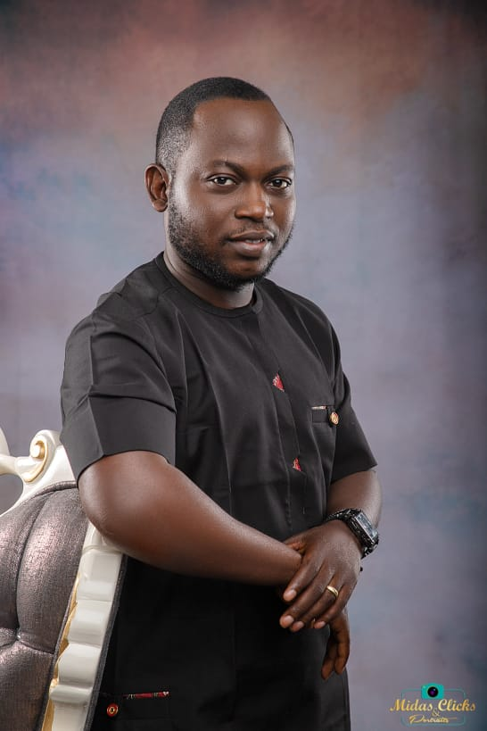
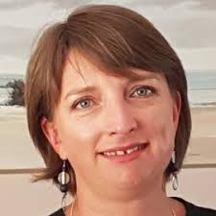
Speakers
Christopher Maronga
Samuel Kamande
Dr. Maëlle Salmon
Balogun Stephen Taiye
John Mutiso
Maggie Wanjiru
Anelda Van der Walt

Slide 7
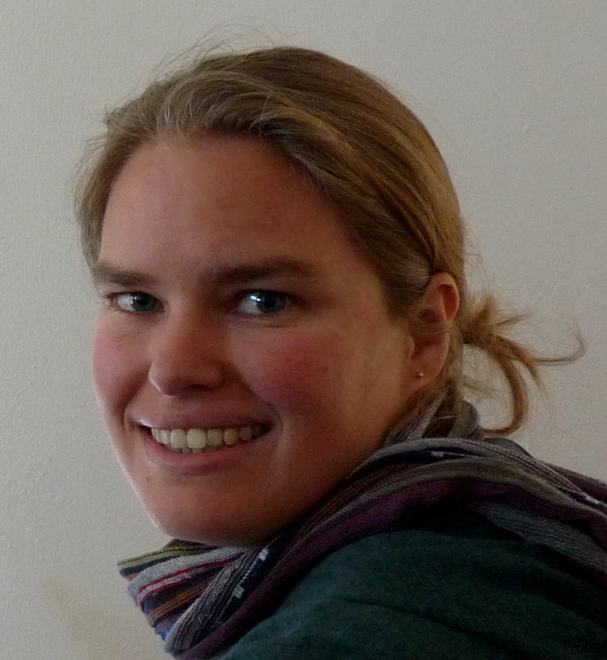
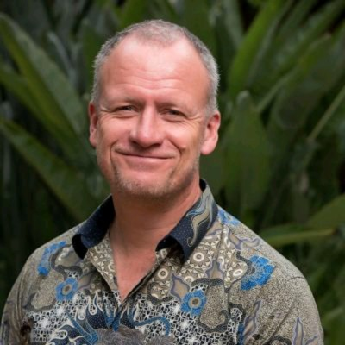

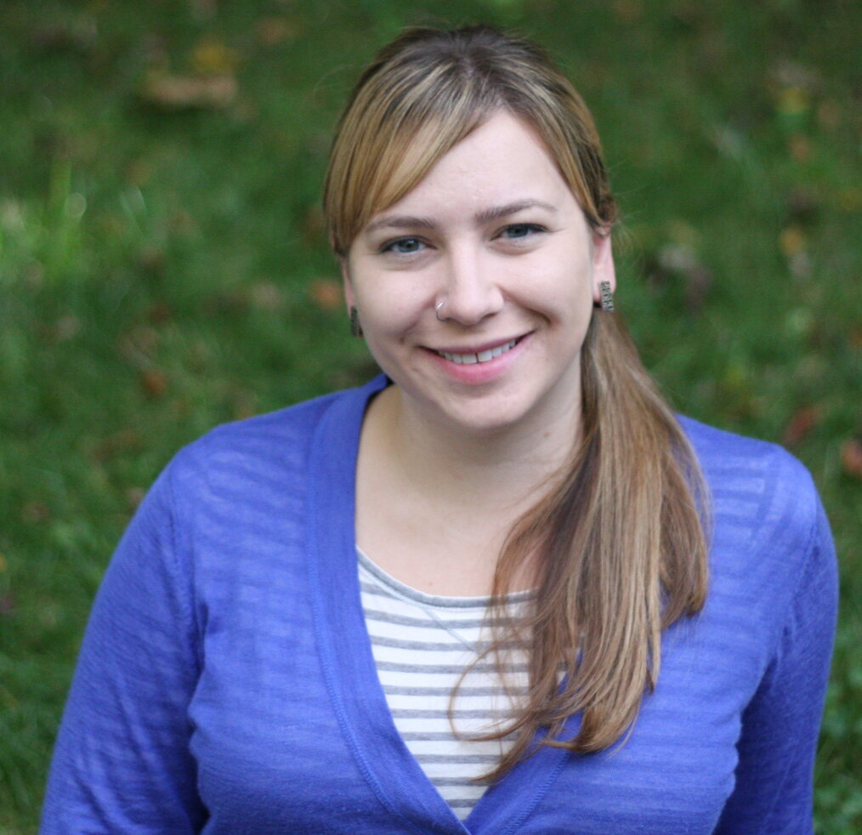

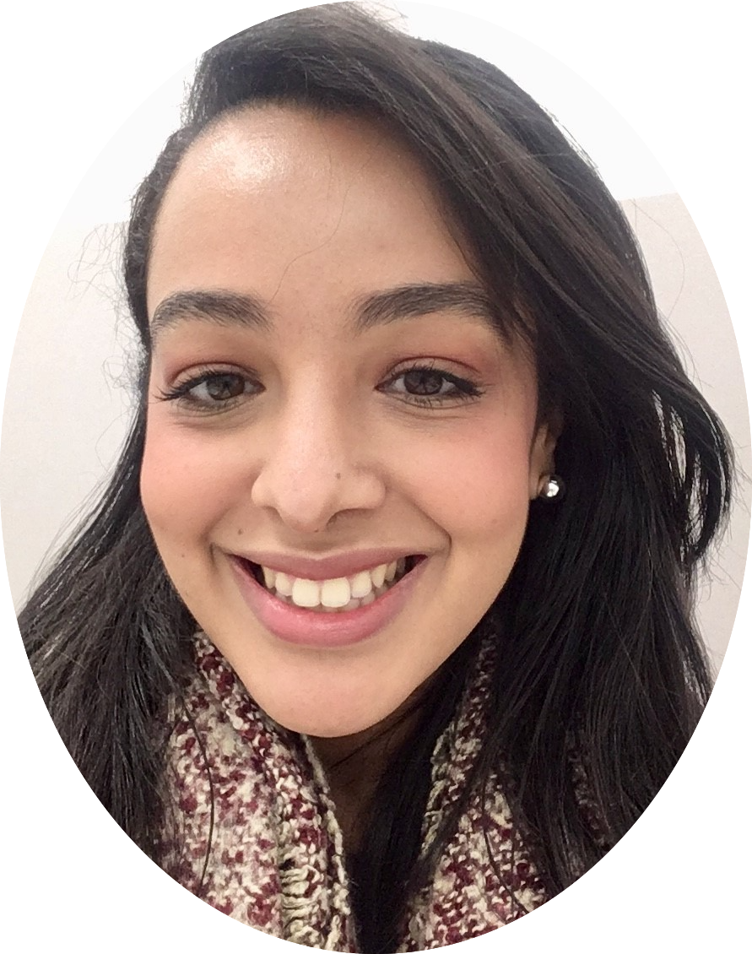
Speakers
Dr. Anne Treasure
Dr. Mine Çetinkaya-Rundel
Dr. Tor-G. Vågen
Bryson Mwamburi
Dr. Ilya Kashnitsky
Asmae Toumi

Slide 8




THANK YOU

